Slide 1

Week 4
MW

Slide 2
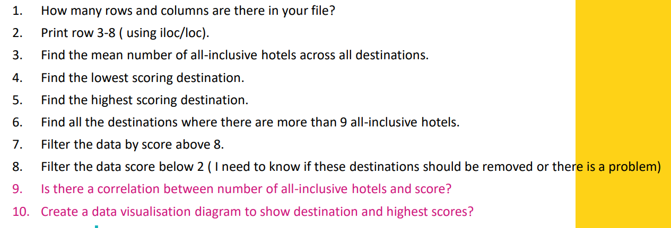
Tasks

Slide 3
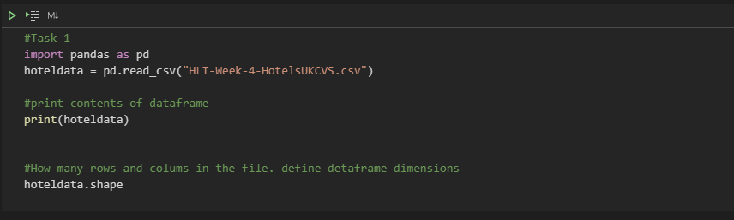
Task 1 : Code

Slide 4
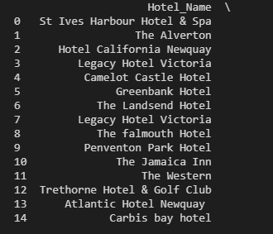
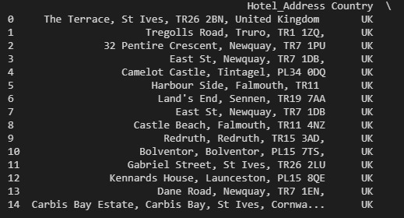
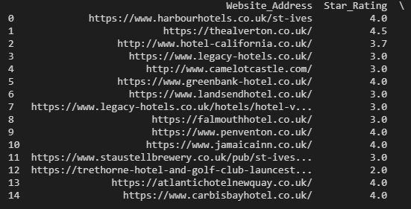
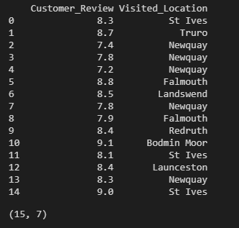
Task 1 : Output

Slide 5
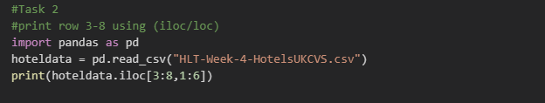
Task 2 : Code

Slide 6
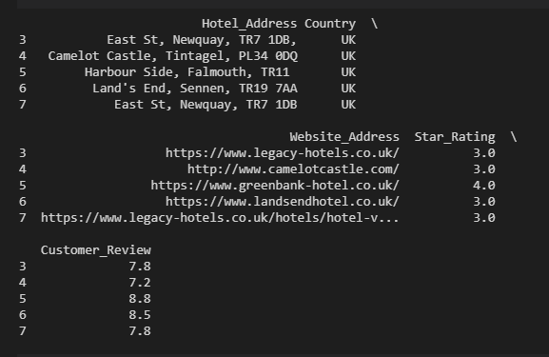
Task 2 : Output

Slide 7
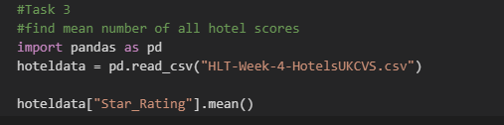

Task 3 : Code
Task 3 : Output

Slide 8
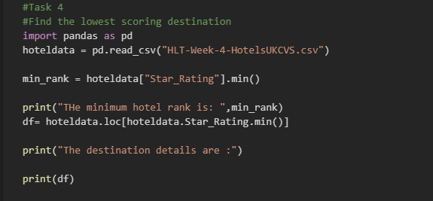
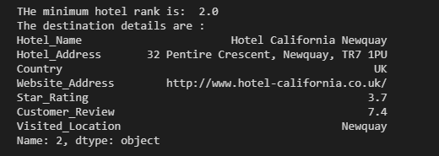
Task 4 : Code
Task 4 : Output

Slide 9
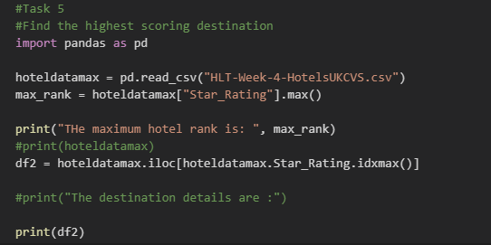
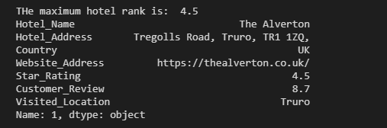
Task 5 : Code
Task 5 : Output

Slide 10
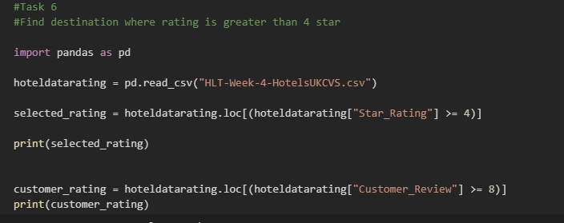
Task 6 : Code

Slide 11
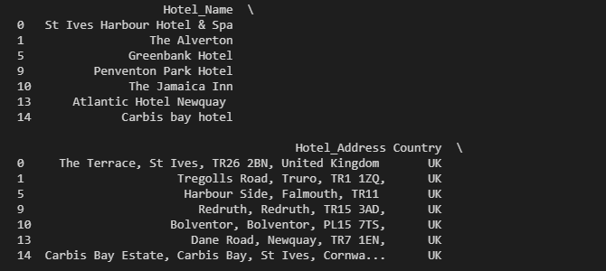
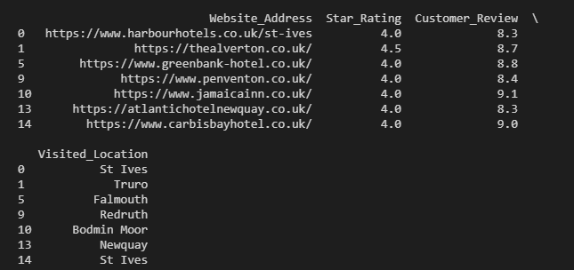
Task 6 : Output

Slide 12
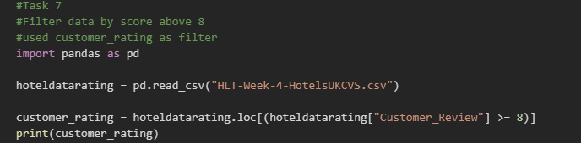
Task 7 : Code

Slide 13
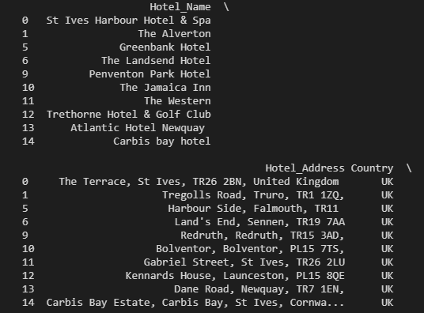
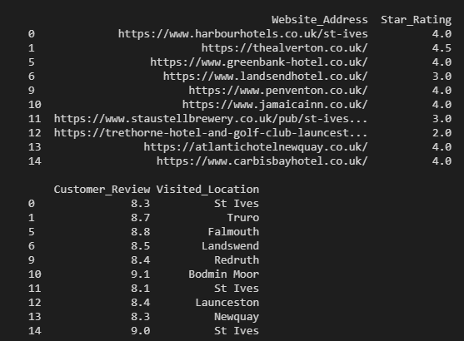
Task 7 : Output

Slide 14
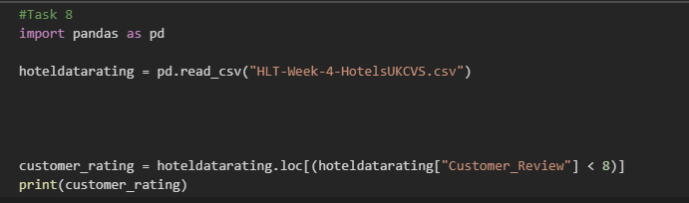
Task 8 : Code

Slide 15
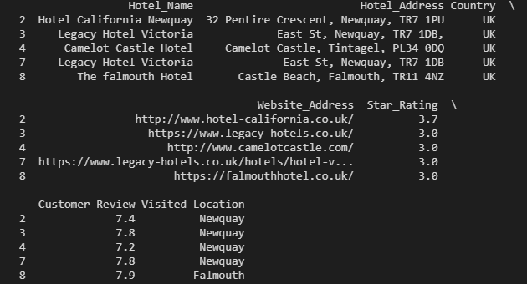
Task 8 : Output

Slide 16
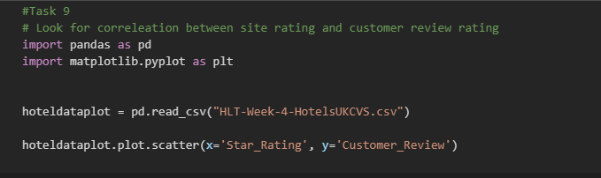
Task 9 : Code

Slide 17
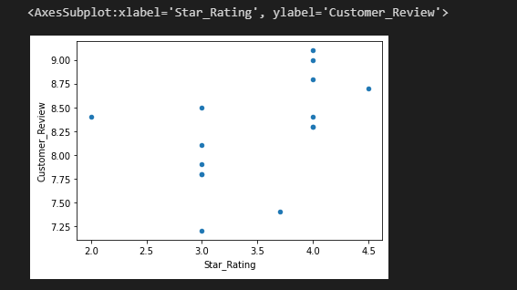
Task 9 : Output
There is a relationship between Star_Ranking to Customer_Review
The better the Hotel Ranking, the better the Customer Review

Slide 18
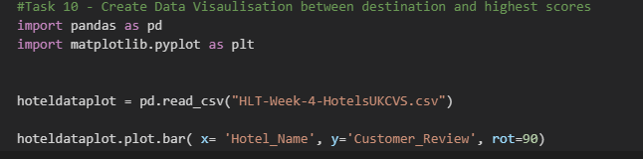
Task 10 : Code

Slide 19
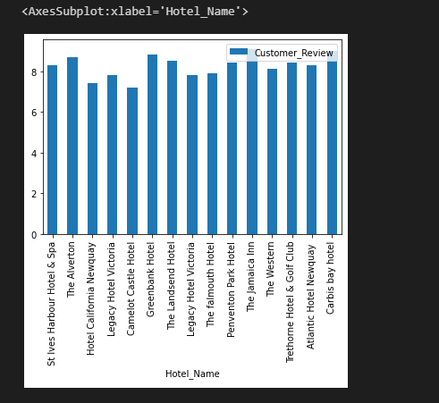
Task 10 : Output
Histogram of Hotel Name to Customer Review
X Axis labels Rotated for readability

Slide 20
Thanks

